Slide 1
Welcome Everyone

Slide 2

Open-Source Monitoring Tool

Slide 3
Key Features of Prometheus
It is an Open Source Monitoring Tool
Easy to install and setup
Provide Roburst Data Module & Query Language
Use PromQL
Easy to observe & track Infrastructure health
It runs on Port number 9090

Slide 4
Node Exporter
Server metrics exporter

Slide 5
Key Features of Node-Exporter
It will fetch server Metrics and give output on Prometheus UI
Node-Exporter runs on Port number 9100
Metrics for CPU, Disk & Memory
Node-Exporter use API’s to fetch these metrics

Slide 6
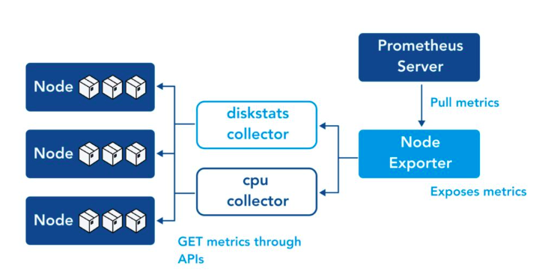
Let’s see architecture of Prometheus & Node-Exporter

Slide 7

Open-Source & Enterprise metric visualization tool

Slide 8
Key Features of Grafana
Works as Open Source & Enterprise
It will run on Port 3000
It will collect metrics/data from Various Data Source (Prometheus)
Once Data source is configure, it will visualize data in various Dashboard's
We can create Role Based access in grafana

Slide 9
Grafana Alerts
We can create Alert & set Limit on any Dashboard for Alerts
Once set limit is exceed, Alert fire & we receive Email Notification.
Grafana use SMTP (Simple Mail Transfer Protocol) to send Alerts

Slide 10
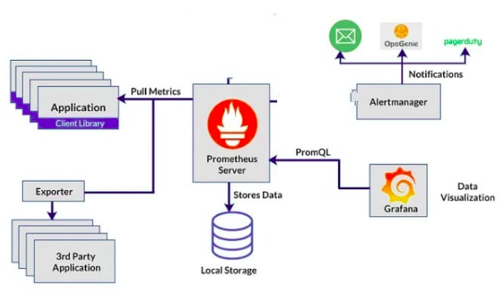
Let’s see architecture of Grafana

